Slide 1

Getting Started with Typing
Notes:
http://www.typing.com/teacherportal/ Teacher login.

Slide 2

1. Go to www.typing.com

Slide 3
2. Click “Access Classic Typing.com”

Slide 4
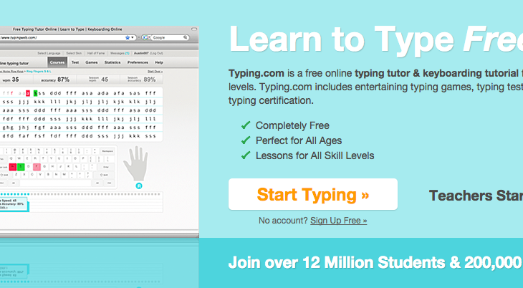
3. Click “Start Typing.”

Slide 5
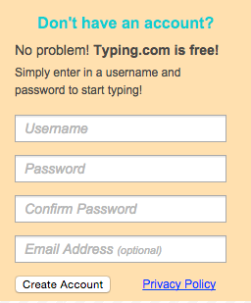
4. Type in your Username.

Slide 6
Stop!
Your username should be
EnglishnameFamilynamePingyinName.

Slide 7
If your English name is Tom, and your family name is Zhang and your pingyin name is Nan your Typing username is
TomZhangNan.

Slide 8
4. Type in your email address.

Slide 9
5. Type your password.

Slide 10
6. Click “Create Account.”

Slide 11
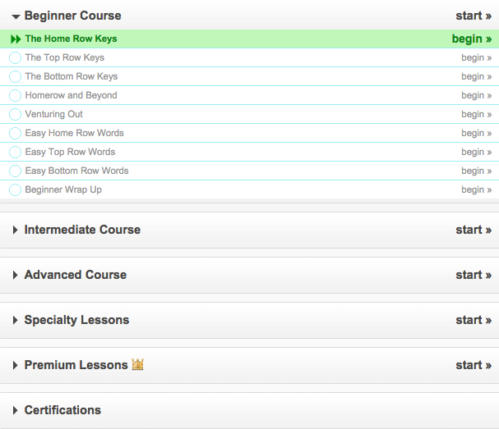
7. Click “Begin.”

Slide 12
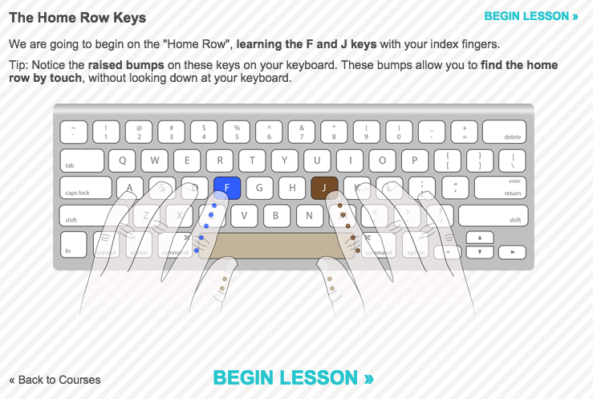
8. Look at the your finger location!

Slide 13
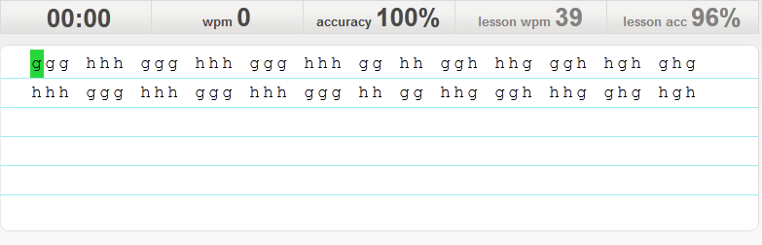
9. Begin

Slide 14
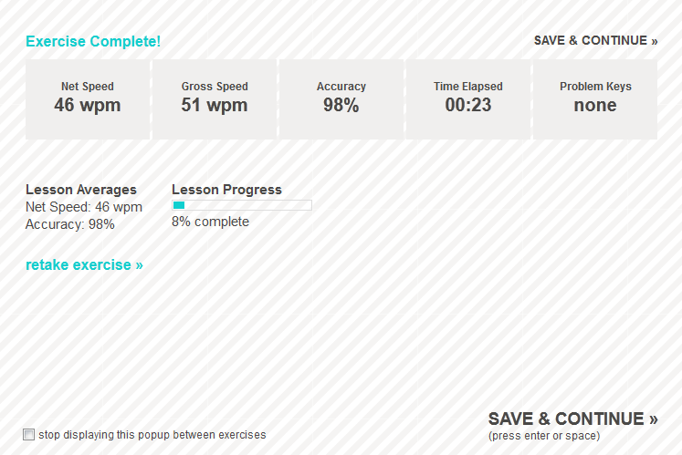
10. Master your Problem keys!

Slide 15
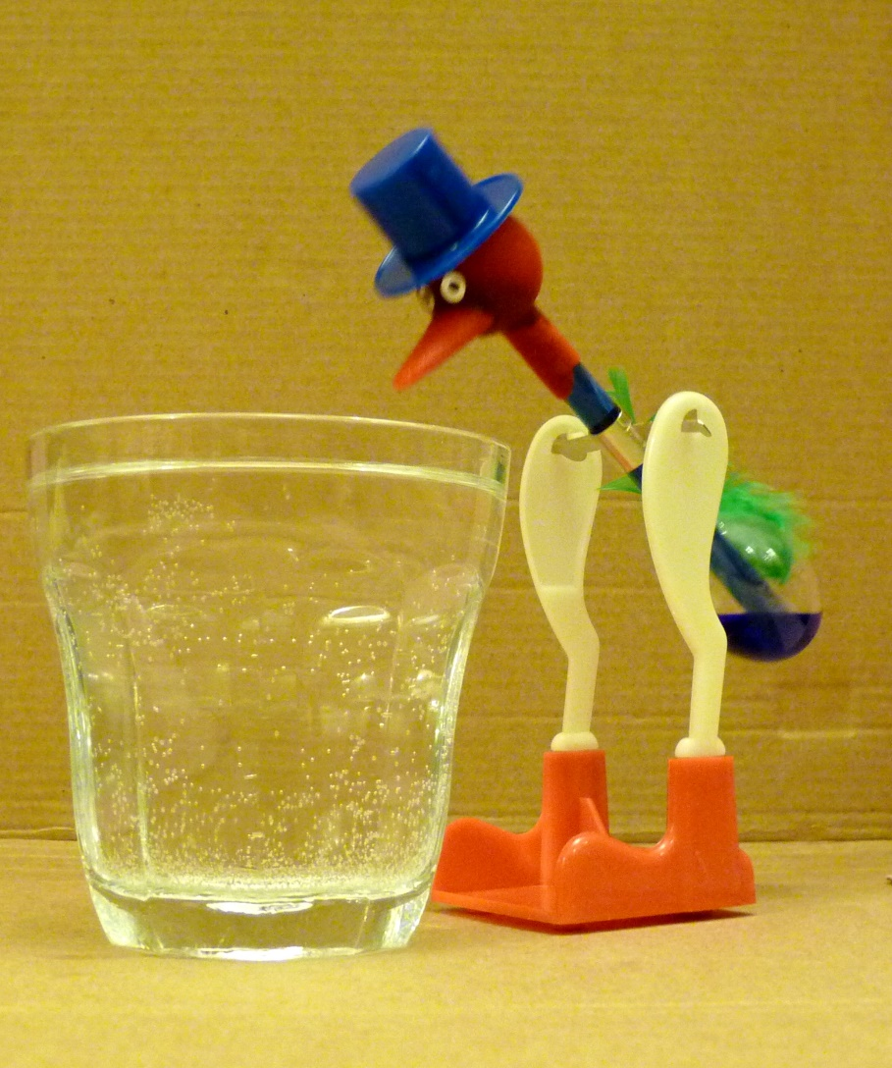
11. Don’t type like a chicken!

Slide 16
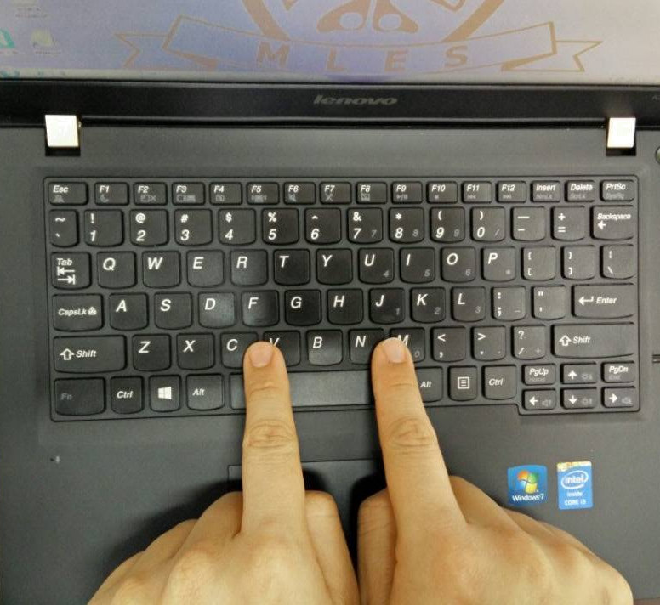
12. Proper placement! F and J

Slide 17
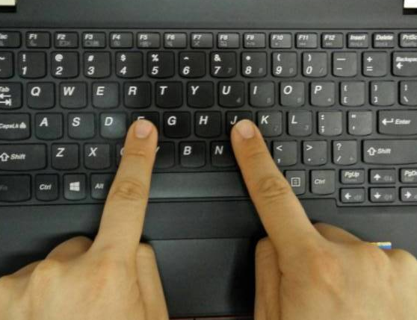
13. Place on F and J

Slide 18

14. Rest of the fingers.

Slide 19

Start learning!

Slide 20

The Big DON’TS

Slide 21
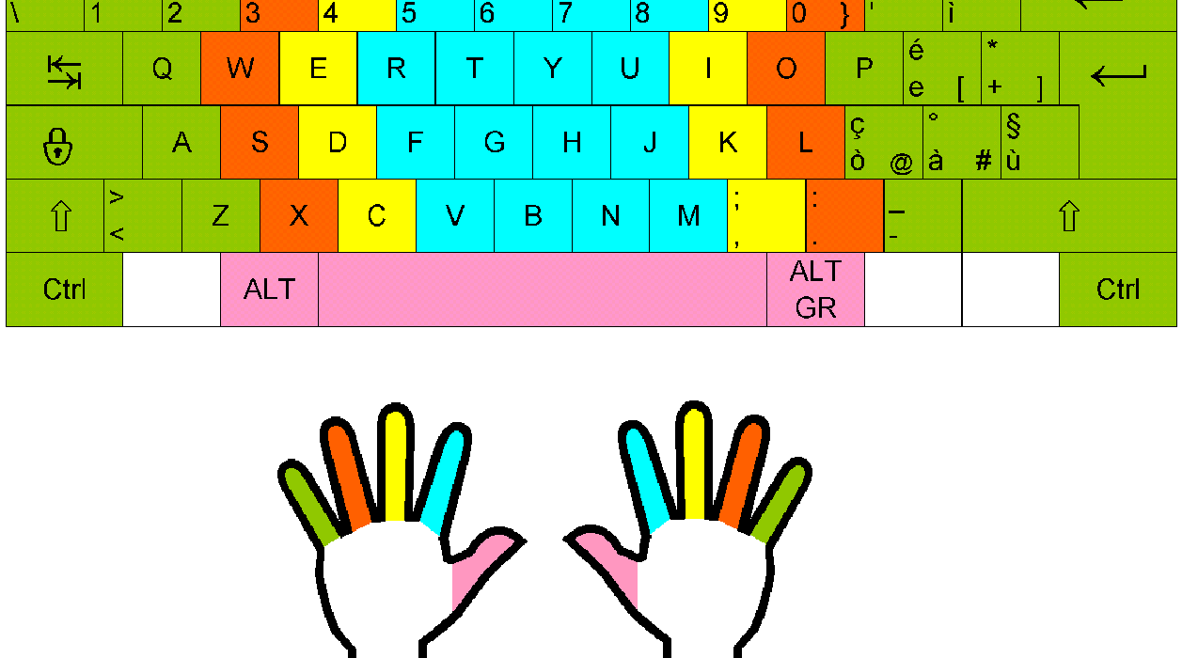
Don’t Look at your fingers!

Slide 22

Don’t use Caps Lock!

Slide 23
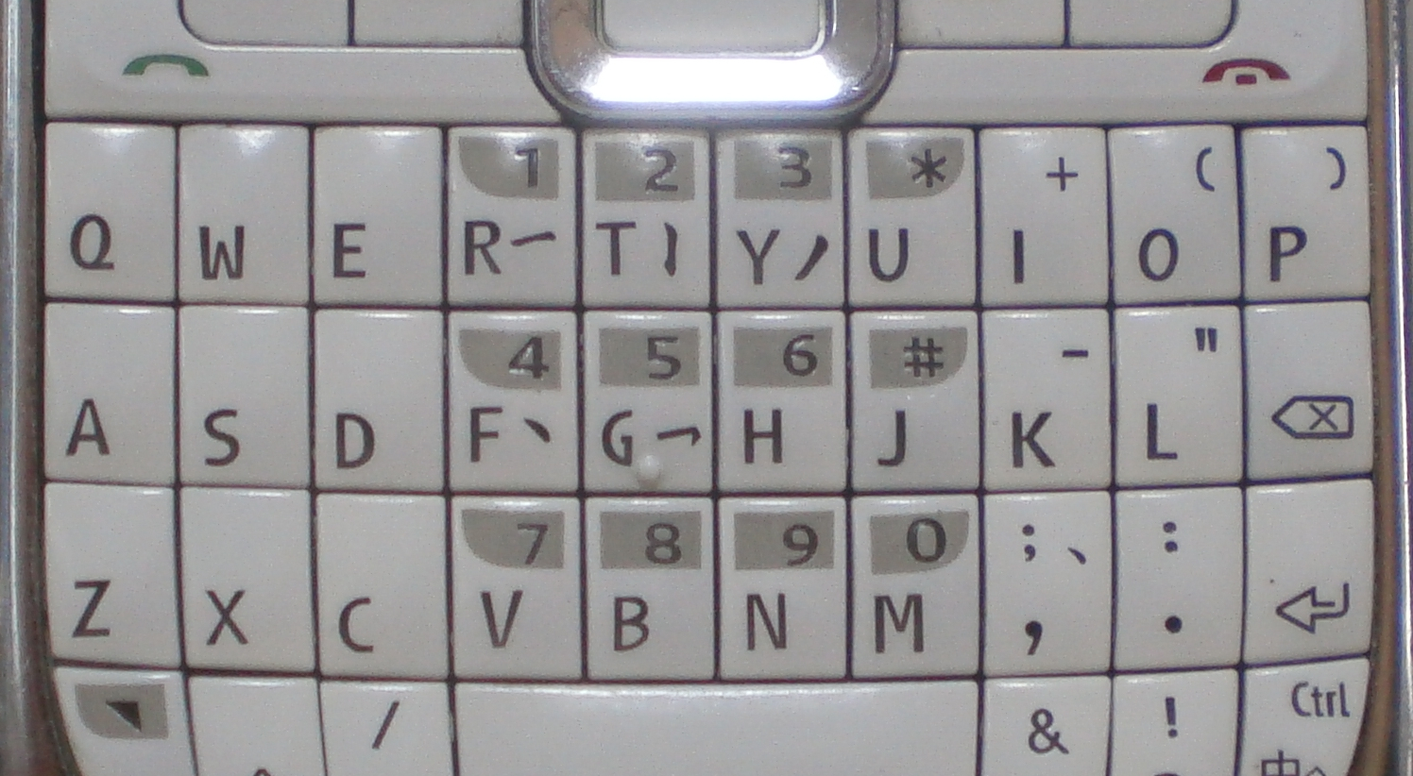
Don’t Leave on your input software.

Slide 24
Start practicing this weekend!
Have fun!

